Slide 1


Comparative Analysis of Urban Tree Diversity:
Assessing Biodiversity Contributions in Niš and Other European Cities
Jelena Stanković, Marija Džunić, Sonja Jovanović,
Vesna Janković Milić, Bojana Novićević
Nobel X 2025 OsloMet
CROSS-disciplinary network for research excellence in Regenerative Economy Innovation eco-Systems

Slide 2


In the context of increasing urbanization and the associated challenges to natural habitats, the preservation of biodiversity has become a crucial issue for sustainable urban communities.
To improve quality of life, it is essential to foster a positive relationship between residents and their environment.

Slide 3
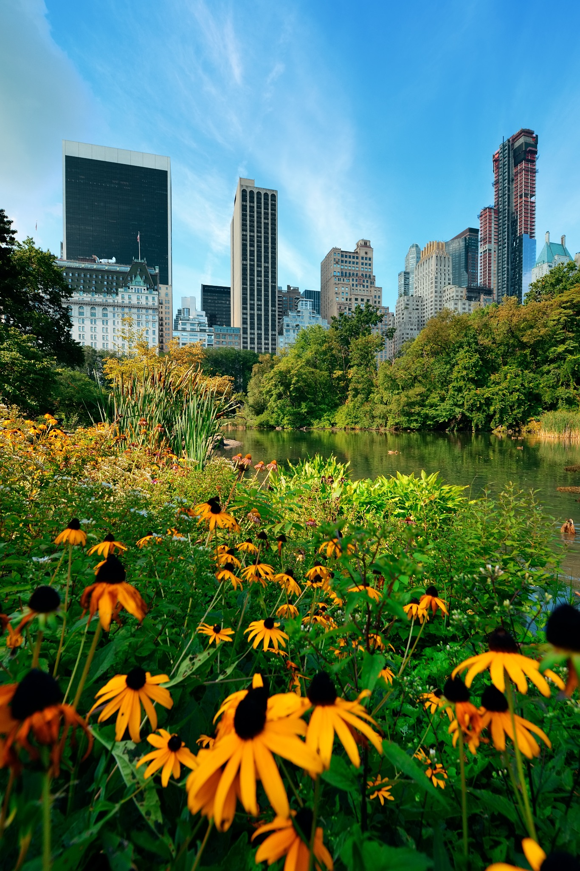
Different aspects of urban biodiversity contributions:
Direct benefits:
- improving air quality,
- preventing floods,
- increasing humidity levels,
- providing shading,
- reducing air temperatures
all of which are of paramount importance in the face of uncertain climate change in urban settings.

Slide 4
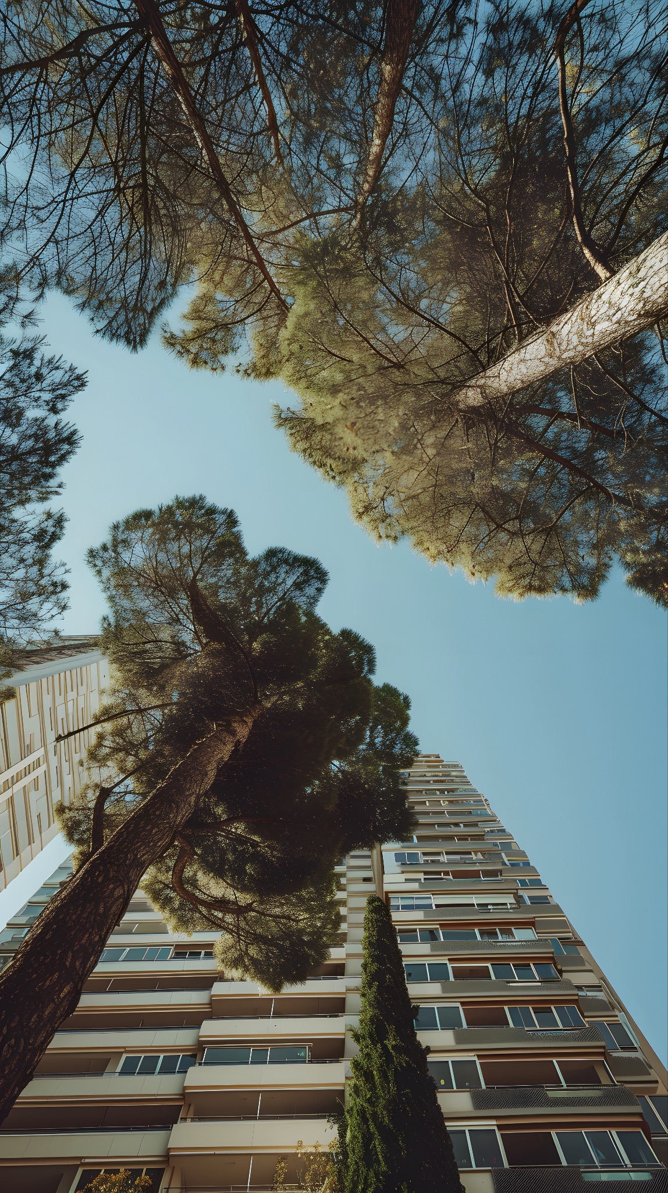
Different aspects of urban biodiversity contributions:
Trees serve as crucial havens during periods of intense heat
Strategically placed trees enhance energy efficiency in buildings.
The economic impact of urban greenery and biodiversity, such as tree-lined streets, makes neighborhoods more attractive and contributes to higher property prices.
Aesthetically pleasing landscapes and urban green spaces have impact on psychological well-being.

Slide 5
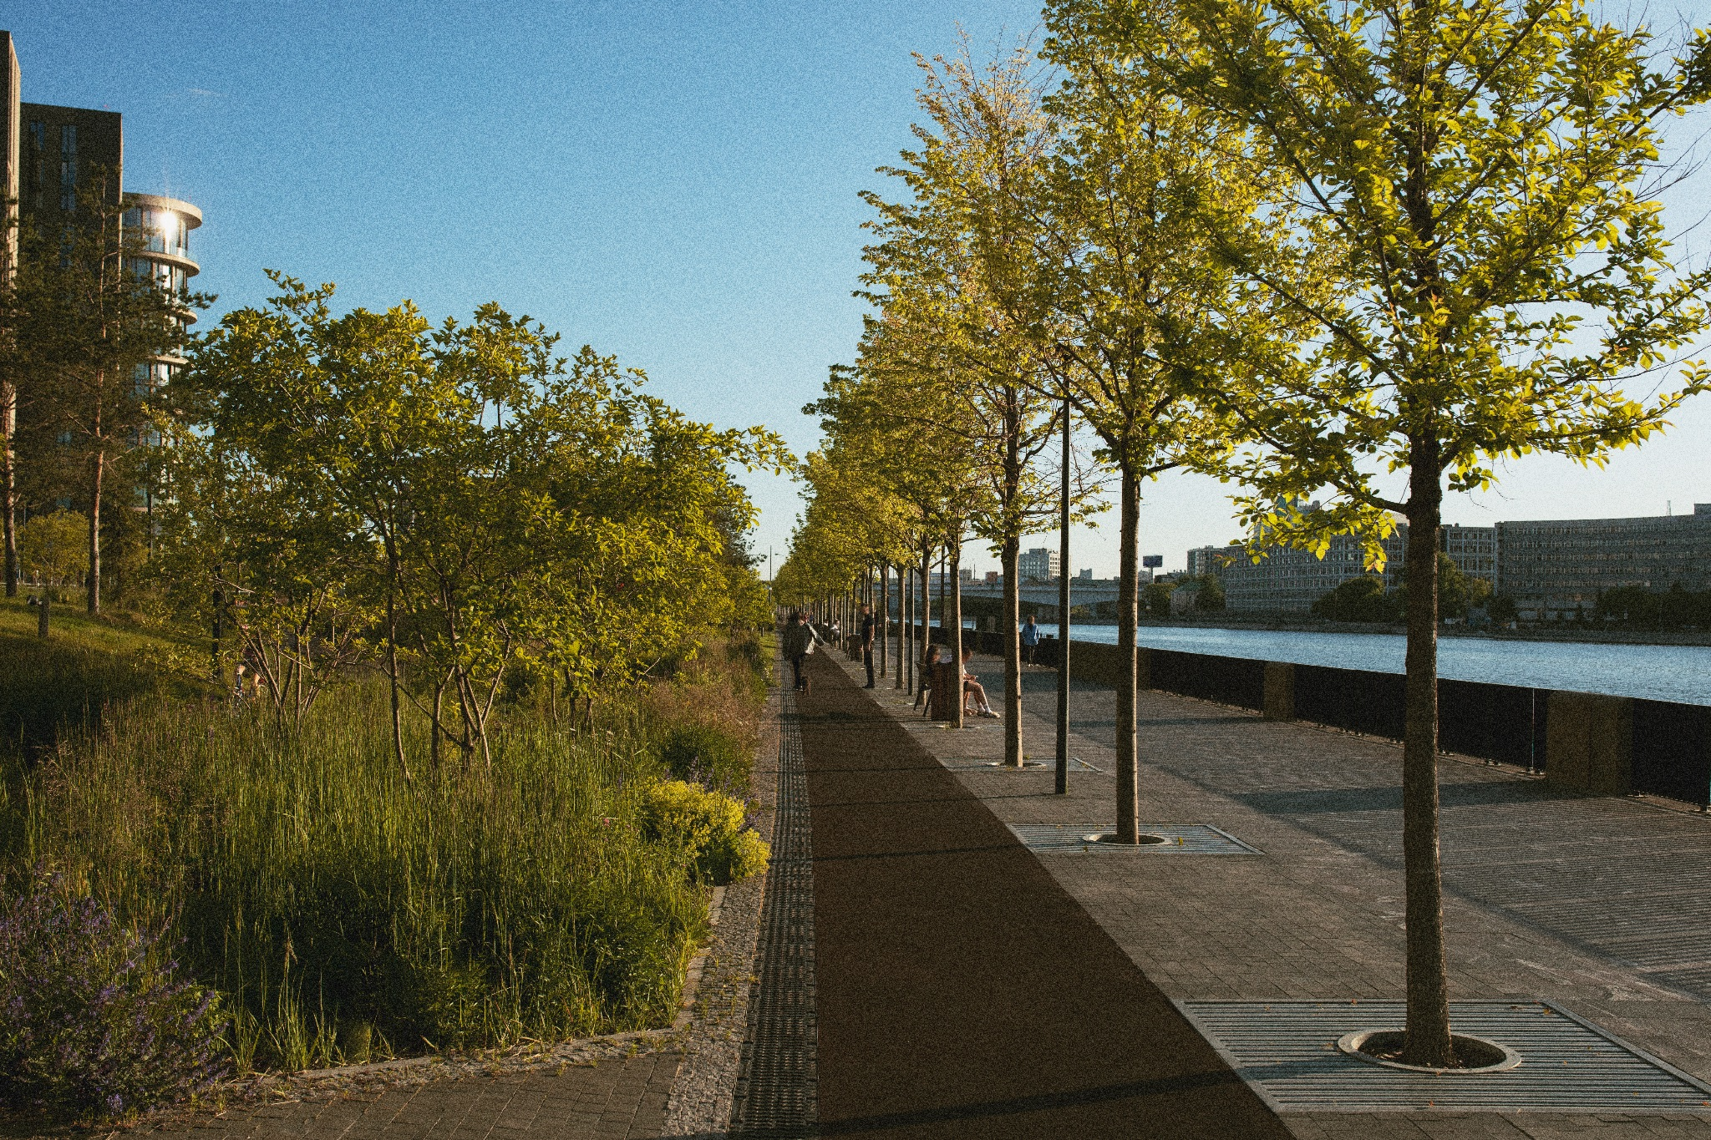
Project website: https://crossreis.com/knowledge-hub.html
Goal of this paper - to conduct a comparative analysis of urban tree diversity in Niš with that of Amsterdam, Bologna, Cambridge, Oslo, and Paris using the Shannon Diversity Index.
Information base: We utilised data collected by researchers Galle, Halpern, Nitoslawski, Duarte, Ratti, and Pilla [Mapping the diversity of street tree inventories across eight cities internationally using open data. Urban For. Urban Green. 2021, 61] across Amsterdam, Bologna, Cambridge, Oslo, and Paris. For these cities, the authors mapped street tree diversity using data sourced from OpenTrees.org. This database lacks information on Serbian cities.
For the City of Nis we utilised data
from the project website CROSS-REIS.

Slide 6
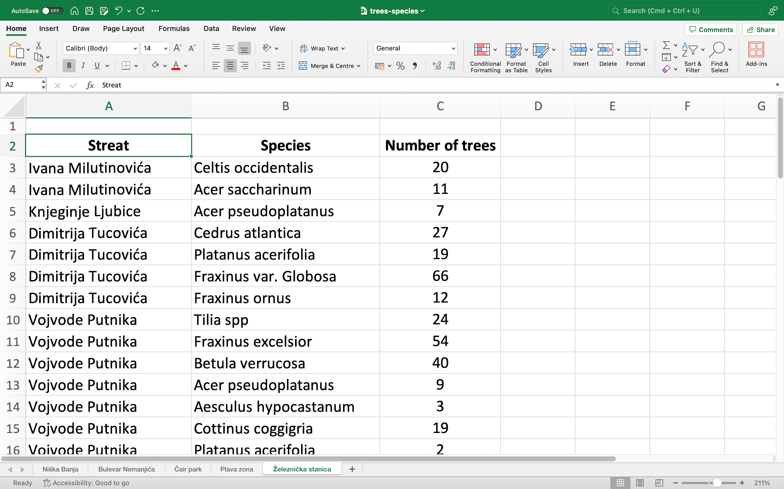
All street trees in the inventory of the City of Niš are divided into five zones:
Niška Banja,
Bulevar Nemanjića,
Park Čair,
Plava zona,
Železnička stanica.

Slide 7

Content of the database
The database contains data about each tree with parameters:
Botanical name (in Latin)
Tree height
Tree diameter
Crown width
Vitality
Decorativeness.

Slide 8
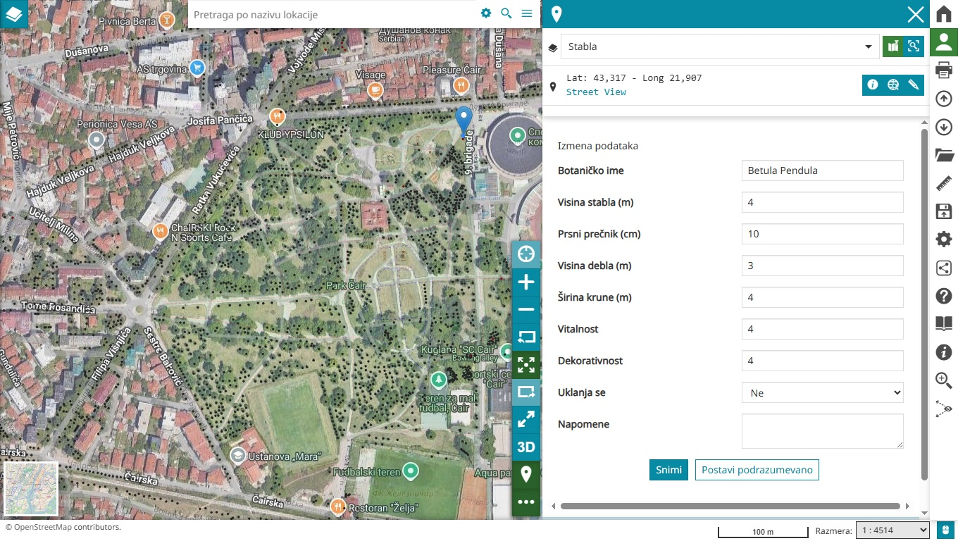
Content of the database
,

Slide 9
Table 2 Diversity of street tree in the city centre and outside of the centre in the City of Niš
City | Area | Stem count | Most abundant species (%) | Name of the species
Niš | Centre | 3998 | 22,3 18,1 7,4 7,4 5,5 4,8 | Platanus acerifolia Thuja spp. Tilia spp. Betula verrucosa Acer saccharinum Aesculus hypocastanum
 | Outside | 4590 | 21,6 11,4 11,1 6,2 5,4 5,1 | Tilia spp. Platanus accerifolia Fraxinus var.globosa Acer pseudoplatanus Celtis occidentalis Acer saccharinum

Slide 10
Table 3. Street tree diversity in the City of Niš and European cities
City | Area | Stem count | Most abundant species (%) | Name of the species
Niš | Centre | 3998 | 22 | Platanus acerifolia
 | Outside | 4590 | 21 | Tilia spp.
Amsterdam | Centre | 7828 | 31 | Ulmus hollandica
 | Outside | 156240 | 8 | Platanus acerifolia
Bologna | Centre | 3053 | 17 | Platanus acerifolia
 | Outside | 65863 | 12 | Celtis australis
Cambridge | Centre | 1928 | 14 | Gleditsia triacanthos
 | Outside | 16503 | 10 | Acer platanoides
Oslo | Centre | 828 | 56 | Tilia spp.
 | Outside | 13735 | 15 | Tilia spp.
Paris | Centre | 13228 | 36 | Platanus acerifolia
 | Outside | 90638 | 29 | Platanus acerifolia

Slide 11
Figure 3. Shannon Diversity Index in the centre and outside of the European cities

Slide 12
Key findings:
Findings from Niš illustrate that lower diversity of trees in the city center makes it more sensitive to ecological vulnerabilities, while higher diversity of trees in peripheral areas provides protection against habitat loss and promotes ecological stability.
The findings underscore the need for urban planners to focus on diversifying tree species in both urban and rural areas.
The enhancement of green spaces in the city centre through the introduction of diverse species could mitigate the adverse effects of urbanisation, promote biodiversity, and improve air quality.
Additionally, there is a need for strategic planning of urban forests that focuses not only on increasing the number of trees but also on increasing the diversity of species, especially in urban centres, in order to strengthen resilience to climate change and other stressors.

Slide 13
Key recomendations:
urban planners should prioritize the development and enhancement of green spaces, such as parks, gardens, and community forests. This can help to create habitats for various species and improve connectivity between these spaces, reducing isolation and encouraging diverse populations.
creation of green infrastructure that supports multiple ecosystem services and biodiversity could include green roofs, rain gardens, and urban woodlands, which provide environments that can sustain a variety of species while offering benefits such as water management and temperature regulation.
Identifying and restoring degraded natural habitats within the urban area to promote the resurgence of native species can contribute to a healthier and more resilient ecosystem. The survival of native populations is of great importance.
Engaging local communities in biodiversity conservation efforts through education and participatory programs could include tree-planting initiatives, creating community gardens, or citizen science projects that involve residents in monitoring and supporting local biodiversity.

Slide 14
CONCLUSION AND RECOMMENDATIONS FOR FURTHER RESEARCH
Further studies could explore the ecological impacts of the current species distribution in Niš, including considerations of the ecological roles played by Platanus acerifolia and Tilia spp. and how the presence of other tree species can contribute to urban biodiversity.
A particularly interesting observation in the paper is that Platanus acerifolia is the species most present in the central zone of Niš, outside of the center in Amsterdam, in the center of Bologna, and in Paris, both in the center and outside the city center.
Is the reason for the greatest presence of this species that it is more resistant to new living conditions or is it the result of planted patterns? A possible answer is that its relative share is growing in the total population of trees in cities due to the gradual death of other trees that are not resistant to current environmental conditions.
This could be the subject of future research and identification of patterns for biodiversity criteria for urban tree development.

Slide 15

Thank You
www.crossreis.com info@crossreis.com

