Slide 1
INFO DAY
Roundtable - Bridging the Gap: Challenges and Opportunities in Advancing Circular Economy for SMEs and Academia in Albania
CROSS-disciplinary network for research excellence in Regenerative Economy Innovation eco-Systems
27 September, 2024

Slide 2
CROSS – REIS Project
CROSS-disciplinary network for research excellence in Regenerative Economy Innovation eco-Systems

Slide 3
01
GOAL AND PURPOSE OF THE PROJECT
The project aims to raise excellence in science and value creation through deeper and geographically inclusive cooperation in alliance of higher education and research institutions in 5 widening and 4 science-leading European countries, to support the shift towards a REGENERATIVE ECONOMY paradigm
Sub-Goals:
Balanced circulation of talents
Reinforce the role of High Education institutions in innovative ecosystems
Mainstream practices and tools for open knowledge and data sharing
Improve links between science and business
Promote gender equality, diversity and inclusiveness
Accelerate society’s green and digital transition
Encourage collaboration with third-country entities
Project value
€4,366,775.00

Slide 4
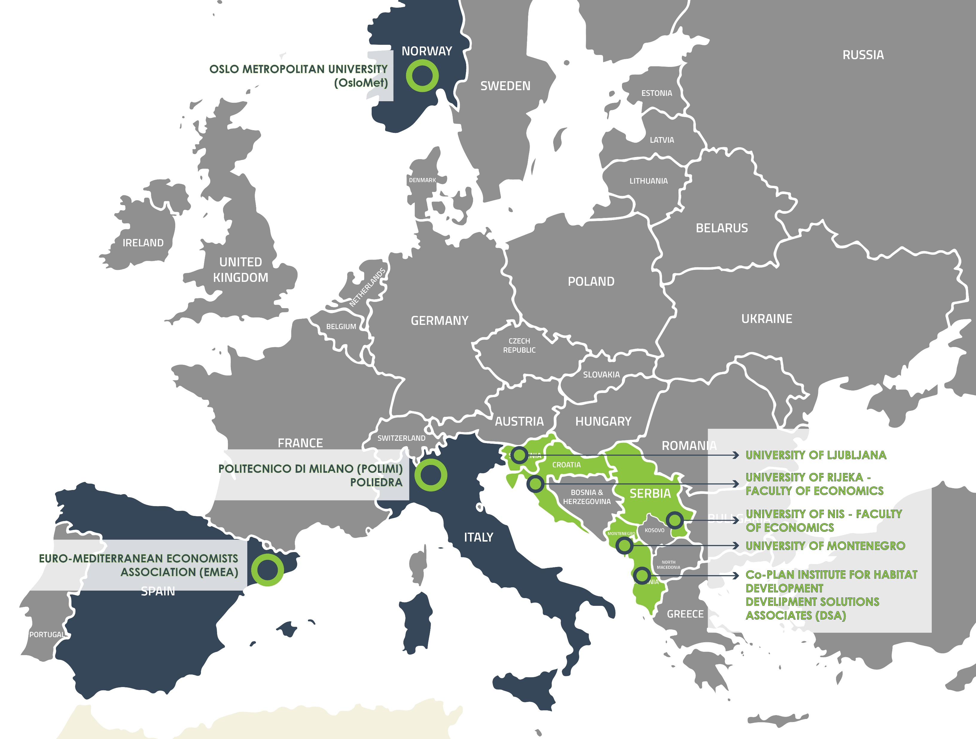
02
UNIVERSITY OF NIS - FACULTY OF ECONOMICS
PROJECT CONSORTIUM
UNIVERSITY OF LJUBLJANA
UNIVERSITY OF MONTENEGRO
UNIVERSITY OF RIJEKA - FACULTY OF ECONOMICS
Co-PLAN INSTITUTE FOR HABITAT DEVELOPMENT
DEVELIPMENT SOLUTIONS ASSOCIATES (DSA)
EURO-MEDITERRANEAN ECONOMISTS ASSOCIATION (EMEA)
POLITECNICO DI MILANO (POLIMI)
POLIEDRA
OSLO METROPOLITAN UNIVERSITY (OsloMet)

Slide 5
03
RESEARCH AREAS
01
02
03
CIRCULAR ECONOMY
URBAN BIODIVERSITY
WASTE MANAGEMENT AND INCLUSIVE SOCIETY
Transferring knowledge and developing tools and methods for identifying key aspects of the circular economy.
Identification of indicators and development of models with the aim of reducing biodiversity in cities.
Research on the socio-economic status of collectors of secondary raw materials.

Slide 6
04
RESOURCES AND ACTIVITIES
R&I strategies
Cooperation and networking
Capacity building
Joint creation and improvement of places to encourage strategies and actions of R&I regenerative development
Database and tools
Building capacity and knowledge for managing the shift to a regenerative economy
Mutual cooperation and networking with business and the local community
Monitoring results through the use of common databases and tools
Workshops; trainings, visits, exchanges...
Creating a methodology for a better synergy of the meaning of the "green" transition of three perspectives...
Knowledge Hub (crossreis.com)
MICEB 2024-2028; joint papers; joint project proposals

Slide 7
05
WORK PACKAGES
UOM
EFRI
FEUN
UL
OSLOMET
EMEA
WP1
Forging Innovative Infrastructures
WP2
Fostering Interdisciplinary Ideation
WP3
Upgrading Interdisciplinary Ideation
WP4
Advances in Interdisciplinary Ideation
WP5
Empowering Research Excellence
WP6
Global and Local Collaboration: Think globally, act locally
POLIEDRA
POLIEDRA
EFRI
FEUN
Co-PLAN & DSA
EMEA
EMEA
WP7
Cultivating Regenerative Futures
WP8
Living Regenerative Futures
WP9
Beyond Regenerative Futures
WP10
Dissemination and Outreach Activities 1
WP11
Dissemination and Outreach Activities 2
WP12
Project Management 1
WP13
Project Management 2

Slide 8
Project Activities
January - September 2024
06

Slide 9
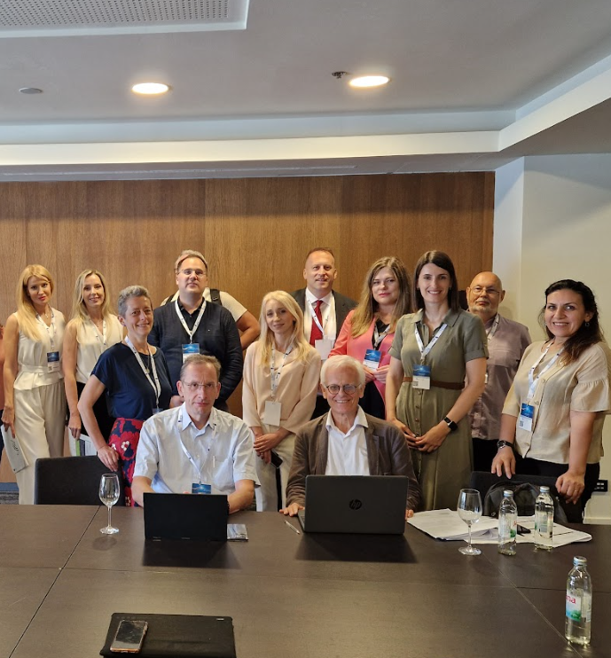
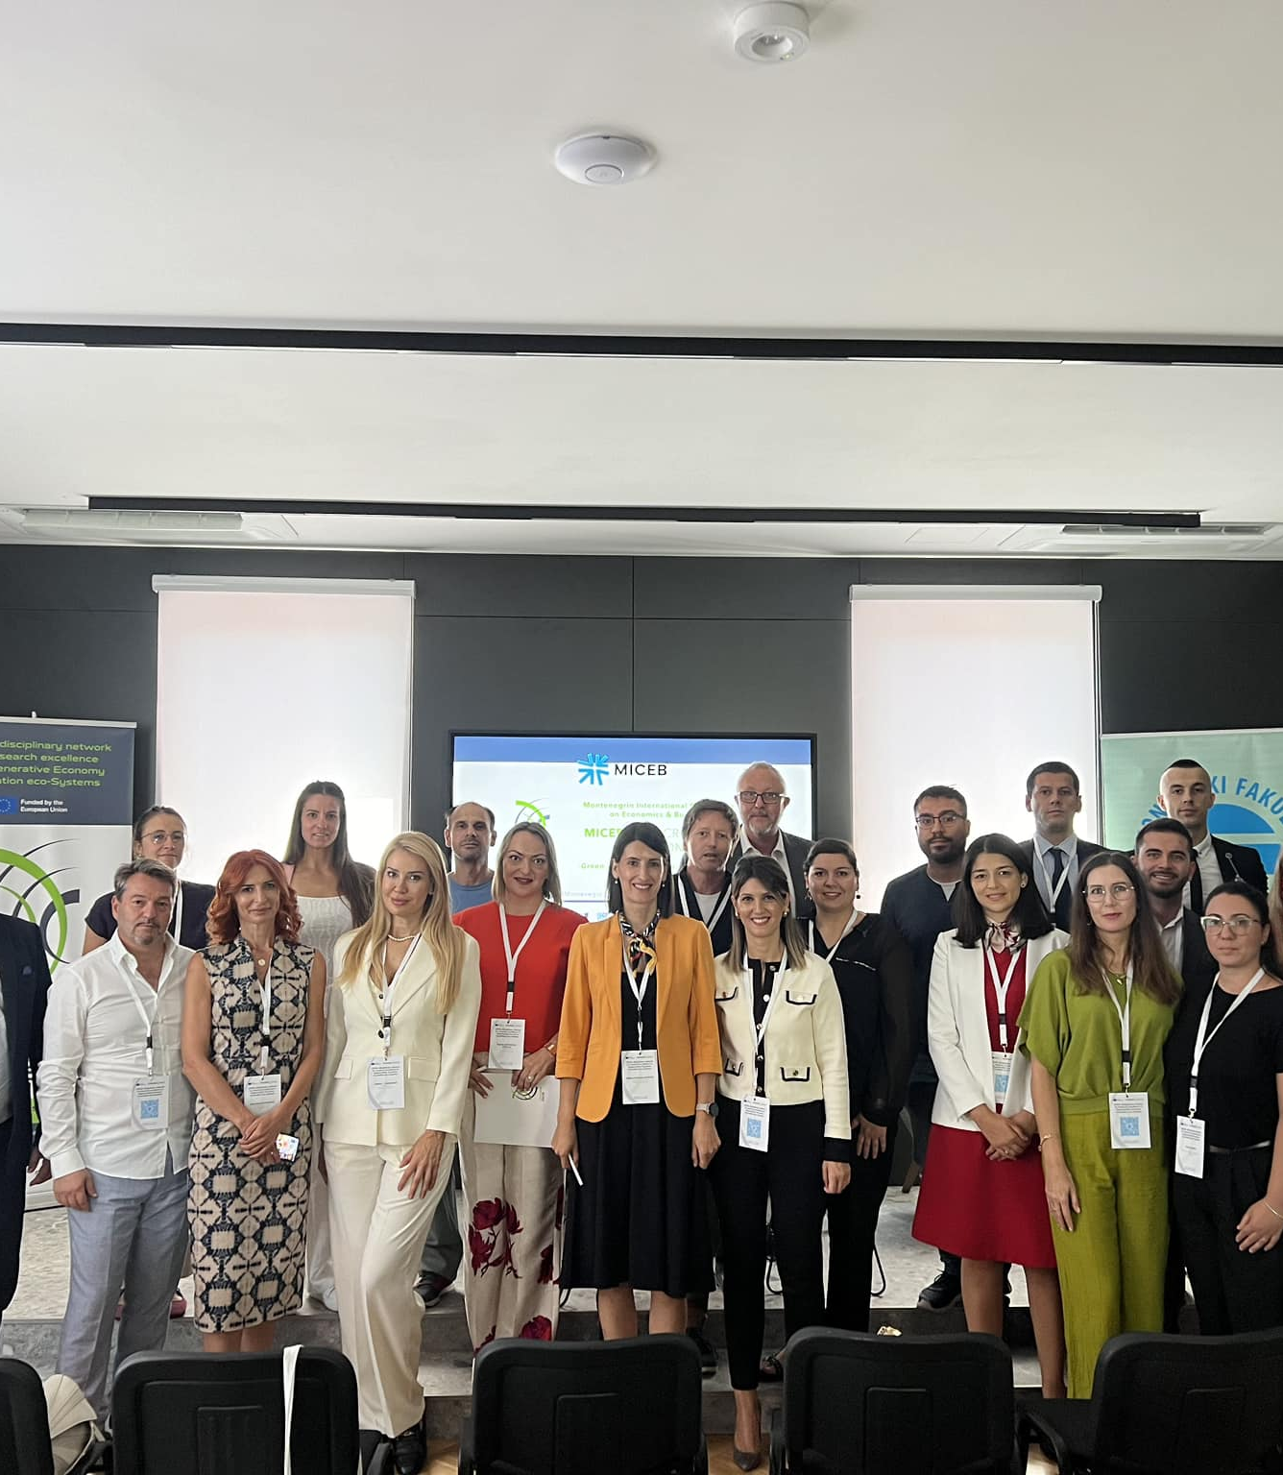
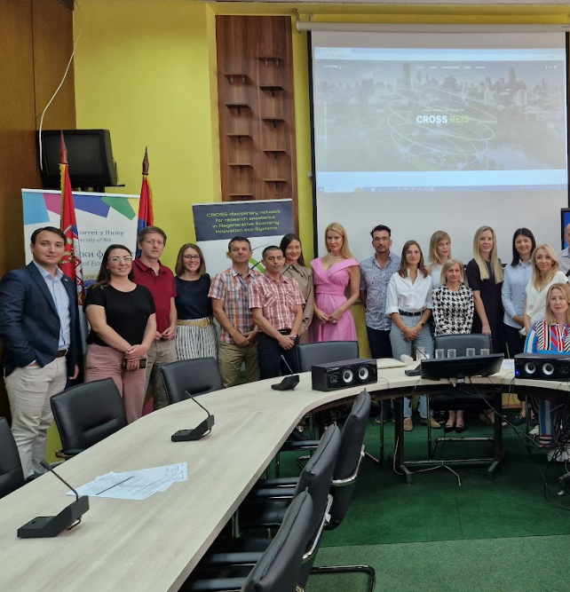
Forging Innovative Infrastructures
Kick-off Meeting
29-30 January
3-day Visit to EFRI
June 19-21th
3-day Visit to FEUN
June 26-28th
3-day Visit to UOM
& MICEB 2024
September 11-13th

Slide 10
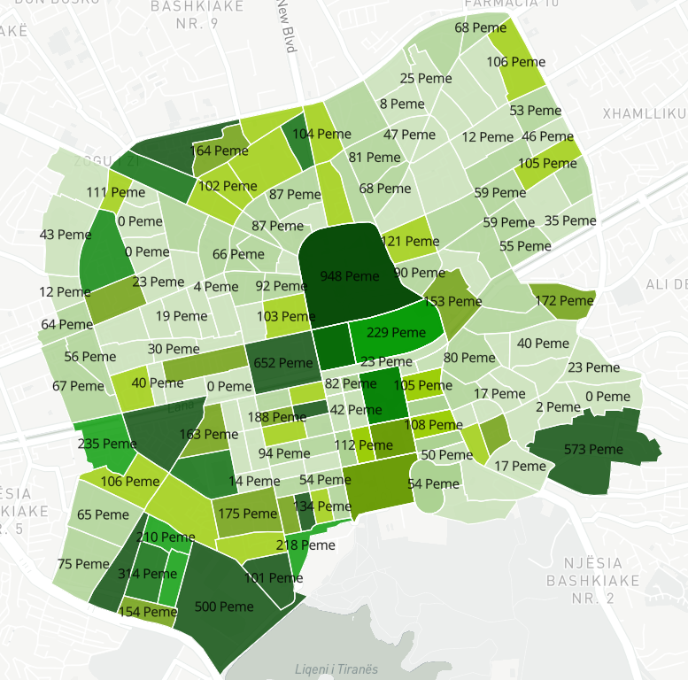
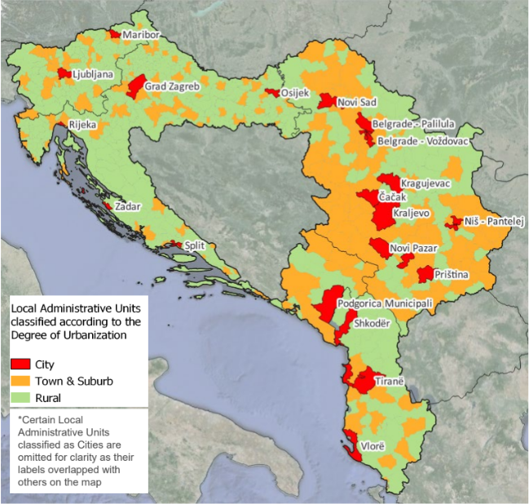
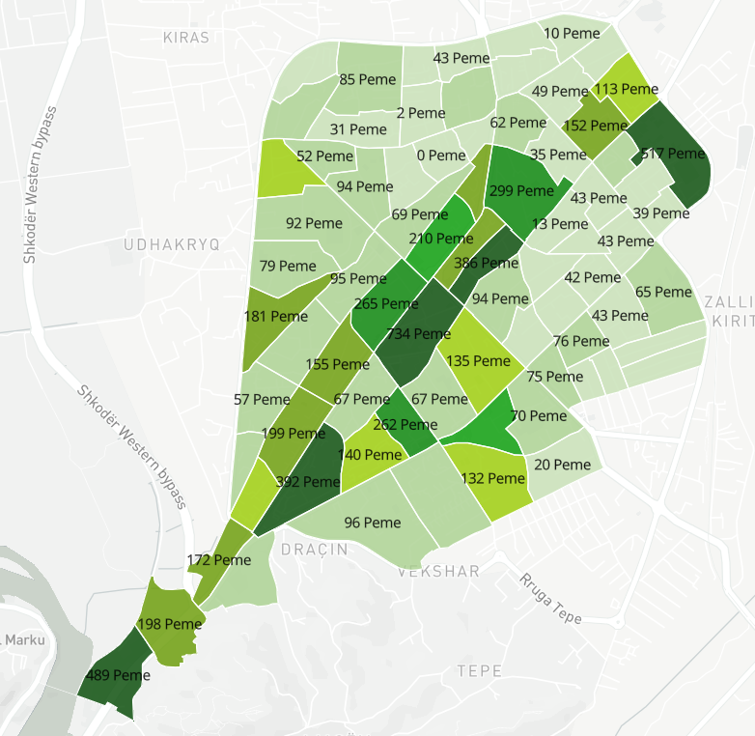
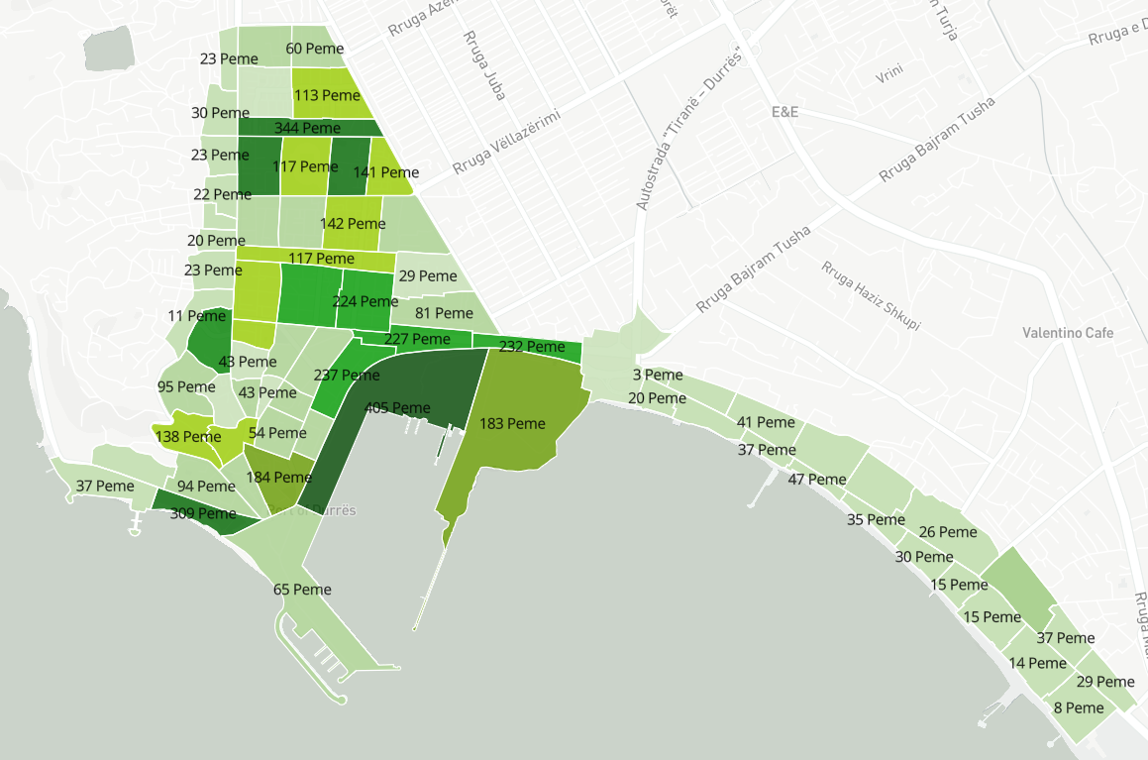
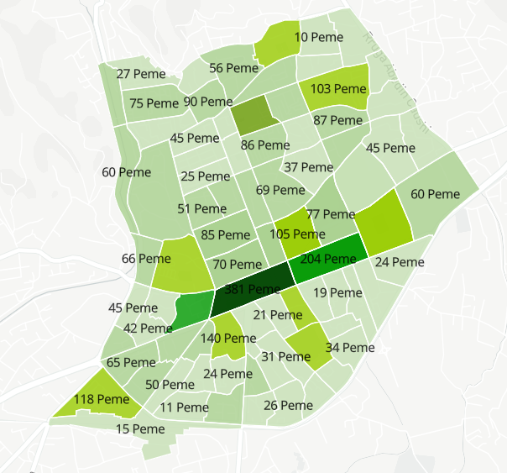
Cultivating Regenerative Futures
1st phase of the research
Tirana Municipality
Tackling the Urban Biodiversity component
At least in terms of Ecosystem Accounting, can we extend EU mapping to CROSS-REIS countries?
In terms of ownership and management of the “green areas”, what is the situation in the CROSS- REIS countries?
Baseline of the current conditions.
Inform future strategies and suitable interventions or actions.
Stimulate active involvement of stakeholders in activities potential
OUTPUT – Joint paper (March 2025)
Shkodra Municipality
Durrës Municipality
Elbasan Municipality

Slide 11
On Parallel
Drafting the curricula for the training for circular public procurements targeting local policymakers
A powerful tool that city governments can use to shape the transition towards a circular economy
Participating in various conferences to facilitate the creation of the journal "Regenerative Economics“
EDT Conference, Rijeka, Croatia
Regional Development and Demographic Flows of Southeastern European Countries, Nis, Serbia
MICEB, Podgorica, Montenegro
Organising INFO-Days as tools for stakeholder engagement and dissemination
1 INFO-Day per year in each Widening Country

Slide 13
Future Project Activities
08

Slide 14
OSLOMET
EMEA
POLIEDRA
POLIMI
Trainings & Exchanges
Inside the consortium
UOM
EFRI
FEUN
UL
Co-PLAN
DSA
Building citizen awareness on circular economy, waste management and urban biodiversity challenges | Info Days
Organizing training for local policy makers related to circular public procurements as a powerful tool that city governments can use to shape the transition towards a circular economy | Training
Organizing 3-day training on regenerative economy prospects with EC policy-makers at EMEA, Barcelona | Training
Co-design Nature Based Solutions with the citizens, in the form of Living Labs | Living Labs
Trainings & Networking
Outside the consortium

Slide 15
Regenerating for Prosperity: Driving Innovation for a Sustainable Future
Ljubljana, Slovenia
2025
Building a Better Tomorrow: Embracing Regenerative Business for Long-Term Success
Tirana, Albania
2027
Business Forums
One per year
Sustainability 2.0: Exploring the Future of Regenerative Business
Serbia, Nish
22.11.2024
Renewable Horizons: Unlocking the Potential of Innovation for a Green Economy
Rijeka, Croatia
2026
From Ideation to Implementation: Navigating Innovation for a Thriving Regenerative Economy
Podgorica, Montenegro
2028

Slide 16
Reforming research assessment
Understanding and implementing methodologies to enhance biodiversity in cities
Exploring circular economy: resource management and the role of stakeholders
Investigating the Relationship between Quality of Life, Well-being, and the switch to a Regenerative Economy paradigm
Online Resource Hub
Joint Interdisciplinary research and innovation agenda
Introduce a new scientific journal, "Regenerative Economics“
Internationalization of the Montenegrin International Conference on Economics & Business
Publication of 2 Springer edited books in the field of circular economy, waste management, urban biodiversity and QoL
Research Topics & Activities
Inside the consortium

