Slide 1


XXII INTERNATIONAL SYMPOSIUM: TRANSFORMATION OF THE INSURANCE MARKET -ANSWERS TO NEW CHALLENGES,7-9. June 2024, Aranđelovac, Serbia
The insurance market in the process of transition to a circular and green economy - review of Montenegro
CROSS-disciplinary network for research excellence in Regenerative Economy Innovation eco-Systems

Slide 2


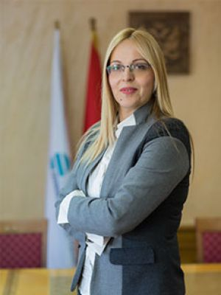

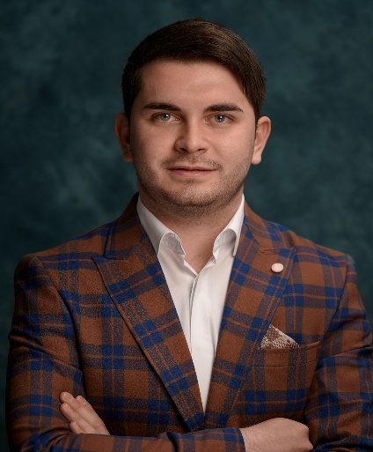

Authors
Milijana Novović Burić, PhD
Ana Lalević Filipović, PhD
Milan Raičević, MSc
Full Professor, Faculty of Economics, UoM
Full Professor, Faculty of Economics, UoM
Teaching Assistant, Faculty of Economics, UoM

Slide 3

01
Introduction
02
Regulation that encourages
sustainable business
Insurance sector through the prism of the regulatory framework of sustainable
business and reporting
03
Montenegrin insurance market
- Non-financial reporting and green products as a path to a green economy
04
05
Conclusion

Slide 4


Introduction

Slide 5

The concept of circular economy is becoming an important paradigm that promotes the sustainable use of resources, waste minimization and product life extension, all to ensure economic, ecological and social progress. This concept of economy is essentially focused on the prevention of waste generation, then the reuse of waste as a raw material, and its recycling.
The application of the circular economy brings benefits in the field of more efficient exploitation of resources at the national level because the total costs and import dependence of the country are reduced, the effects of environmental damage are reduced, new opportunities are created for the creation of additional value and new jobs, and sustainable forms of consumer behavior are introduced.
Financial institutions increasingly recognize the importance of sustainable development and are recognized as generators of this development. Insurance companies, as well as other financial institutions, adopt policies that promote sustainability and the reduction of greenhouse gas emissions.
This paper aims to investigate the role of the insurance market in the process of transition to a circular and green economy, that is, to analyze existing trends, challenges and strategies for improving the sustainability and efficiency of the economic system with special reference to the Montenegrin insurance market.
9,999,333

Slide 6

Regulation that encourages
sustainable business

Slide 7
9,999,333
Figure 1. Overview of EU legislation

Slide 8
Criterion | Directive 2022/2464
Reporting obligation | Large, medium and small companies that are subjects of public interest ;
Guidelines and standards | Sustainability reporting standards for large public interest enterprises; (Art. 29.b) • Sustainability reporting standards for SMEs (Art. 29.c) • Sustainability standards aim to ensure the quality of information reported (understandable, relevant, verifiable, comparable and credibly presented) • Sustainability standards, depending on the scope, prescribe information related to the protection of living things. environment, management, social aspect, future-oriented information, retrospective information, qualitative and qualitative information
Digitization of reporting | Mandatory publication of sustainability information in digital format
Form of reporting | Published as an independent report or with the management report
Introduction of mandatory assurance - Audit | The scope of work of the authorized auditors has been extended to the verification of the sustainability report, which should be stated in the same audit report;
Materiality | Double materiality gains more importance and is linked to the company's financial performance
9,999,333
Table 1. Specifics of Directive 2022/2464 EU

Slide 9
Insurance sector through the prism of the regulatory framework of sustainable
business and reporting

Slide 10

The principles of sustainable insurance represent an important step in building a green economy because they imply a voluntary framework for the global insurance industry that should consider environmental, social and governance risks as well as opportunities (ESG).
An insurance company (or
group) must include sustainability reporting in its management report accompanying the financial statements and the corporate governance statement in its annual report. Within this, the insurance company must (will) report on sustainability issues by the "double materiality" principle.
The ESRS and the 2022 Directive will reduce reporting costs for insurance
companies in the medium and long term by harmonizing the information that needs to be provided.
9,999,333
A high degree of interoperability between EU and global standards such as e.g. IFRS, prevents unnecessary double reporting of companies.
The European Sustainability Reporting Standards (ESRS) will require the publication of climate data on the overall emissions footprint of the insurance company, targets for reducing harmful gases and actions to help achieve them, managing risks and opportunities arising from climate change, but also the financial impacts of these risks on the company.

Slide 11
Montenegrin insurance market
- Non-financial reporting and green products as a path to a green economy

Slide 12
The issue of non-financial reporting has not yet entered the
business philosophy of Montenegrin insurance companies.
It will be increasingly difficult for the insurance industry to settle claims that
arise as a result of environmental, ie. climate change.
A "green" building insurance product
A special motor vehicle insurance products that would encourage policyholders to drive less
9,999,333
Insurance companies in Montenegro can move towards greater sustainability in their operations by modifying their risk acceptance criteria, that is, by rejecting certain risks.
Employees in insurance companies from Montenegro are not sufficiently familiar with the principles of sustainable insurance.

Slide 13


Conclusion
The transition process of the insurance sector towards a green economy brings new opportunities, but also challenges for insurance companies. Insurers need to address the lack of data on renewable equipment losses as well as innovative low-carbon mechanisms that make risk prediction very complicated and unclear.
Another big problem is the lack of insurers who would be able to assess the specific risks associated with bioengineering, a new way of energy production, recycling, chemistry, etc.
Insurance companies in Montenegro should start preparing for corporate sustainability reporting by collecting data on their ESG performance, reviewing their risks and opportunities related to climate change, and developing their goals and strategies related to climate change.
Companies must harmonize their daily business practices and strategic decisions with the ESG concept to achieve sustainable business.

Slide 14
Thank you for attention!
www.crossreis.com
info@crossreis.com

